Slide 1
Application of Data Science in Financial Analysis & Business Analysis

Slide 2
Financial analysis
IT’S A PROCESS OF EVALUATING BUSINESSES entities, PROJECTS, BUDGETS AND OTHER FINANCE-RELATED ENTIES TO measure and benchmark the PERFORMANCE, scalability and suitability for investment and finance control
Method of using specific strategies for evaluation of risks, performance, financial health and future prospects of the business entity
TYPICALLY FA IS USED TO ANALYZE IF AN ENTITY IS STABLE, SOLVENT, PROFITABLE TO MAKE AN INVESTMENT

Slide 3
How fa is performed
identify the industry based economic trends
Identify company strategies
Access the quality of the firm’s financial statements
Analyze current profitability and risk
Prepare forecasted financial statements
TO ASCERTAIN FINANCIAL RATIOS (comparison & benchmarking with other be)
Value the firm

Slide 4
Reports used for fa
Income statement (p & l statement)
Balance sheet
Statement of cash flows
Statement of changes in equity

Slide 5
Who will use the fa
Internal management
Investors
Shareholders
Creditors

Slide 6
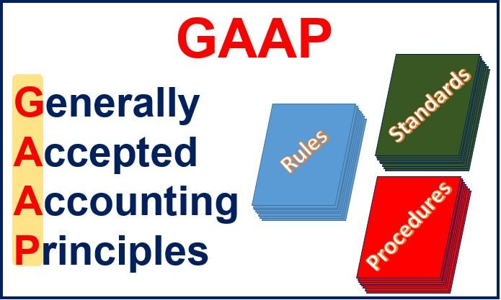
INTL ACCTING STANDARDS – GAAP

Slide 7
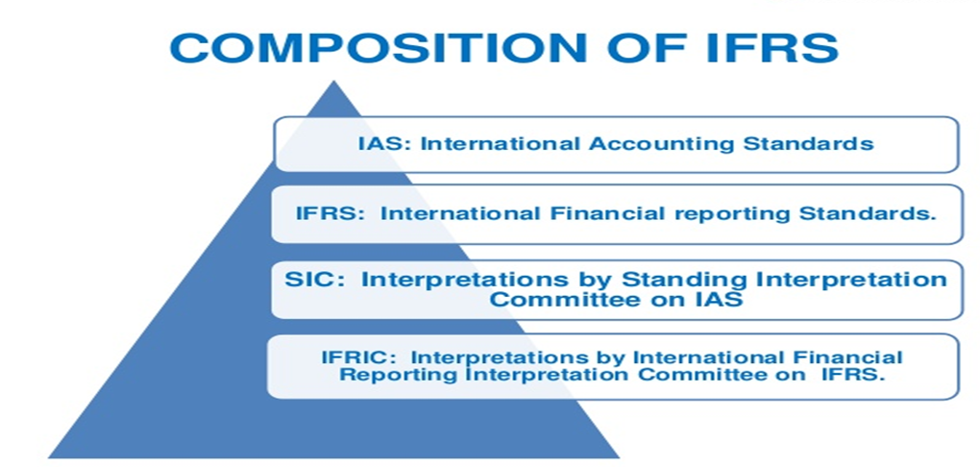
BUSINESS REPORTING STANDARDS - IFRS

Slide 8
What is business analysis
Business analysis is a practice of enabling change in an organizational context by defining needs and recommending solutions that deliver value to stakeholders.
Design or modification of business systems / requirements
Ba’s collaborate with stakeholders and sme’s to understand their problems and needs
Gathers documents and analyzes business needs and requirements

Slide 9
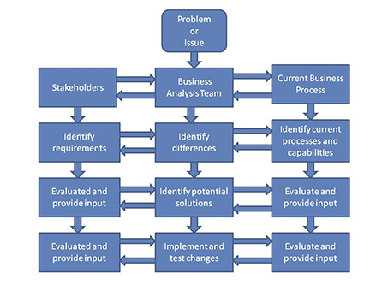
Business analysis

Slide 10
Application of data science in bfsi
Financial PERFORMANCE trends
Financial forecasting
Corporate finance predictions
Banking predictions (consumer & retail)
Insurance & treasury management
Stock market trends & predictions
Risk management
Fraud detection
Identify verifications
Building new business models
Statistical methodologies

